Slide 1


QNN for Derivative
Pricing on NISQ Hardware

Slide 2
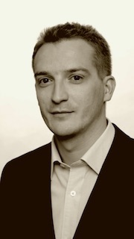

Assistant Professor — SGH Warsaw School of Economics Quantum Machine Learning Engineer — finQbit Research focus: data analysis, quantum machine learning, and mathematical foundations of QM. Author of the QIFT framework bridging non-commutative quantum formalism with classical data analysis. Member of: The Quantum Finance Boardroom, QPoland
f(Q)
finQbit
Sebastian Zając, PhD

Slide 3
Why Quantum for Derivatives?

Slide 4
finQbit

Slide 5
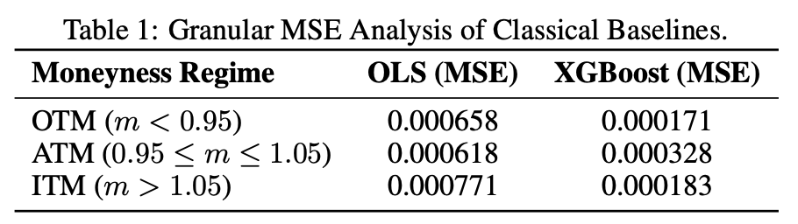
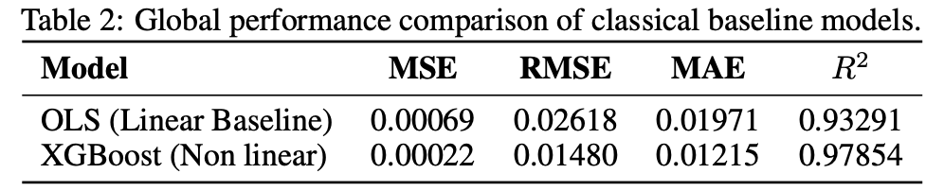

Data generator: Moneyness $(m=S/K)$ [ 0.8, 1.2 ] Time to Maturity $( T )$ [ 0.2, 1.1 ] Risk free Interest Rate $( r )$ [ 0.02, 0.1 ] Volatility $( σ )$ [ 0.01, 1.0 ] Price BSM $C = m N\left(d_{1}\right)−e^{−rT }N\left(d_{2}\right)$ Train set: 500, Test set 100*
Classical Models
f(Q)

Slide 6

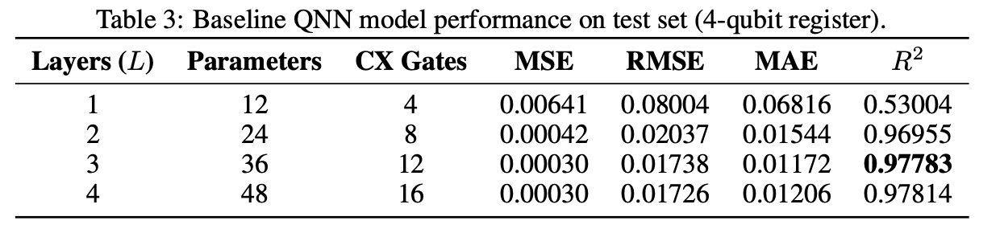

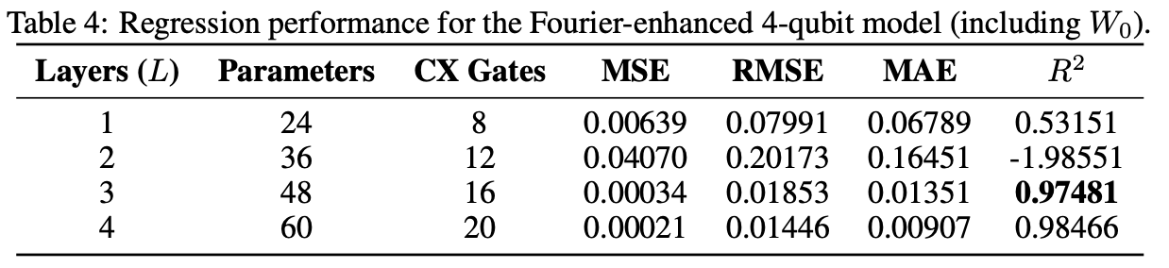
Default quantum model: Fourier Re-uploading:
Quantum NN Models
f(Q)

Slide 7

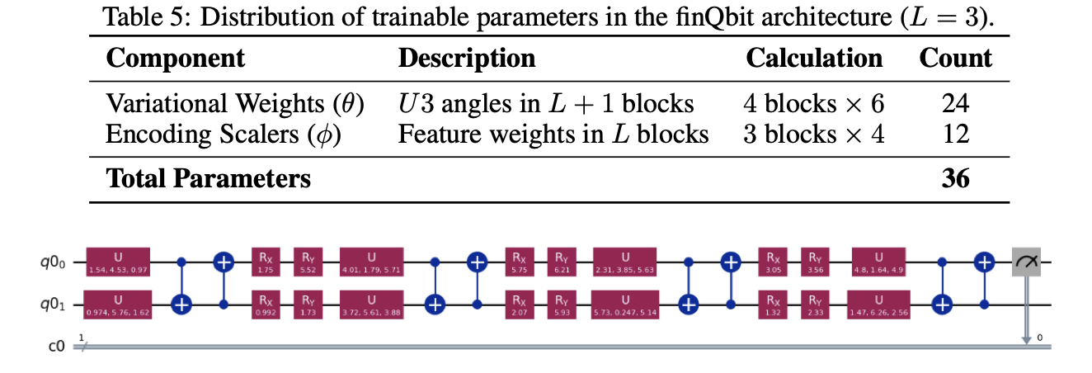
Each qubit encodes 2 features via orthogonal Ry/Rx axes. 4 BSM inputs on just 2 qubits, maximizing information density per qubit.
The finQbit 2-Qubit Architecture
f(Q)
1
2
3
Feature Permutation: feature pairs permuted across re-uploading layers to capture diverse inter-feature correlations..
U(4) Compression: 8 CNOT gates compressed to single U(4) block via ML optimization.

Slide 8
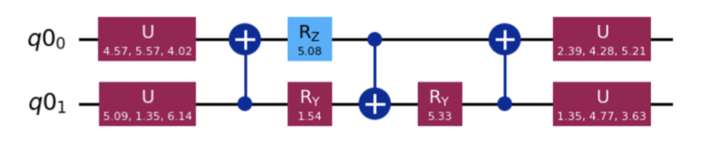
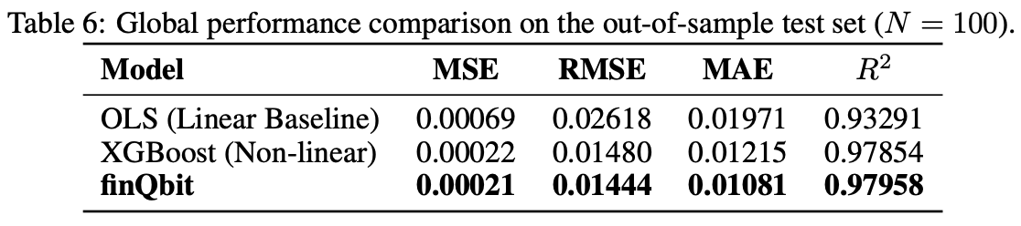
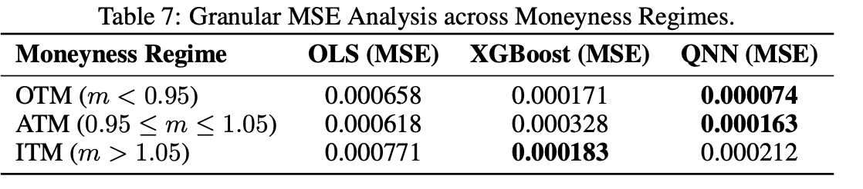
Each qubit encodes 2 features via orthogonal Ry/Rx axes. 4 BSM inputs on just 2 qubits, maximizing information density per qubit.
The finQbit 2-Qubit Architecture
f(Q)
1
2
3
Feature Permutation: feature pairs permuted across re-uploading layers to capture diverse inter-feature correlations..
U(4) Compression: 8 CNOT gates compressed to single U(4) block via ML optimization.

Slide 9
Cross-Platform
Hardware Results Ideal simulation Shot noise simulation Execution on QPU

Slide 10
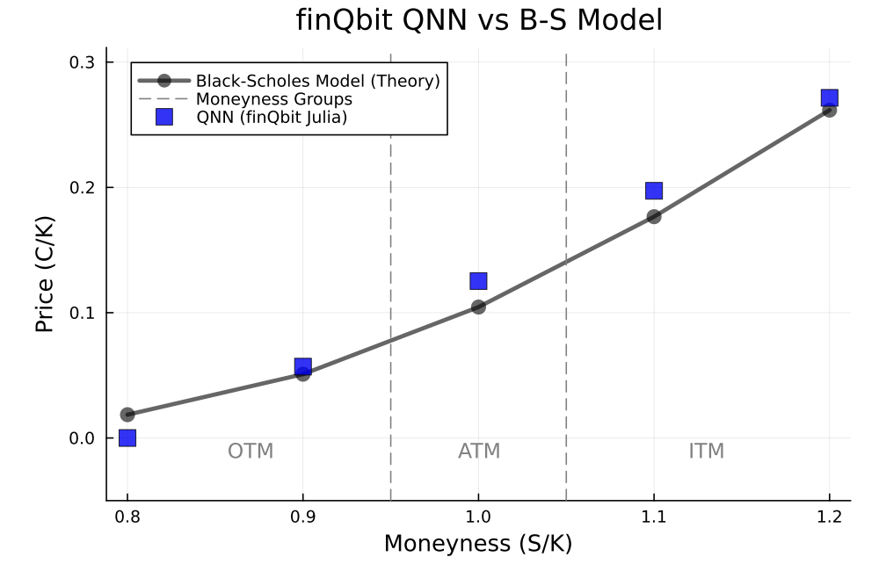
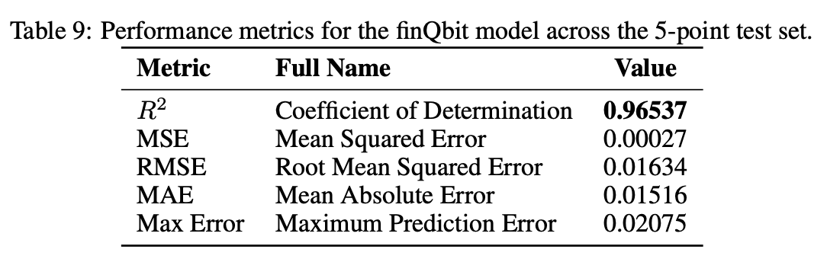

Ideal simulation
Moneyness $m∈$ [ 0.8, 0.9, 1.0, 1.1,1.2 ] Time to Maturity $T = 1.0$ Risk free Interest Rate. $r= 0.05$ Volatility $σ =0.2$

Slide 11
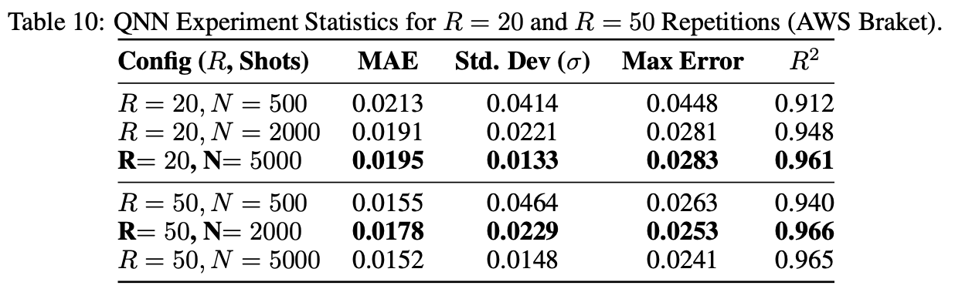
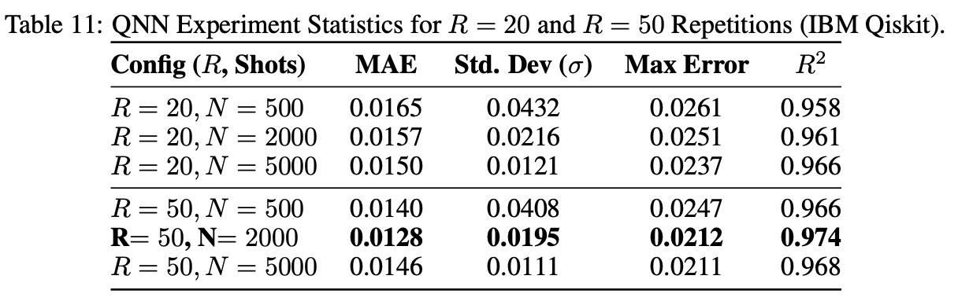
Shot noise simulation
Count-based simulators: AWS Braket, IBM Qiskit
R = 20, 50
N Shots = 500, 2000, 5000

Slide 12
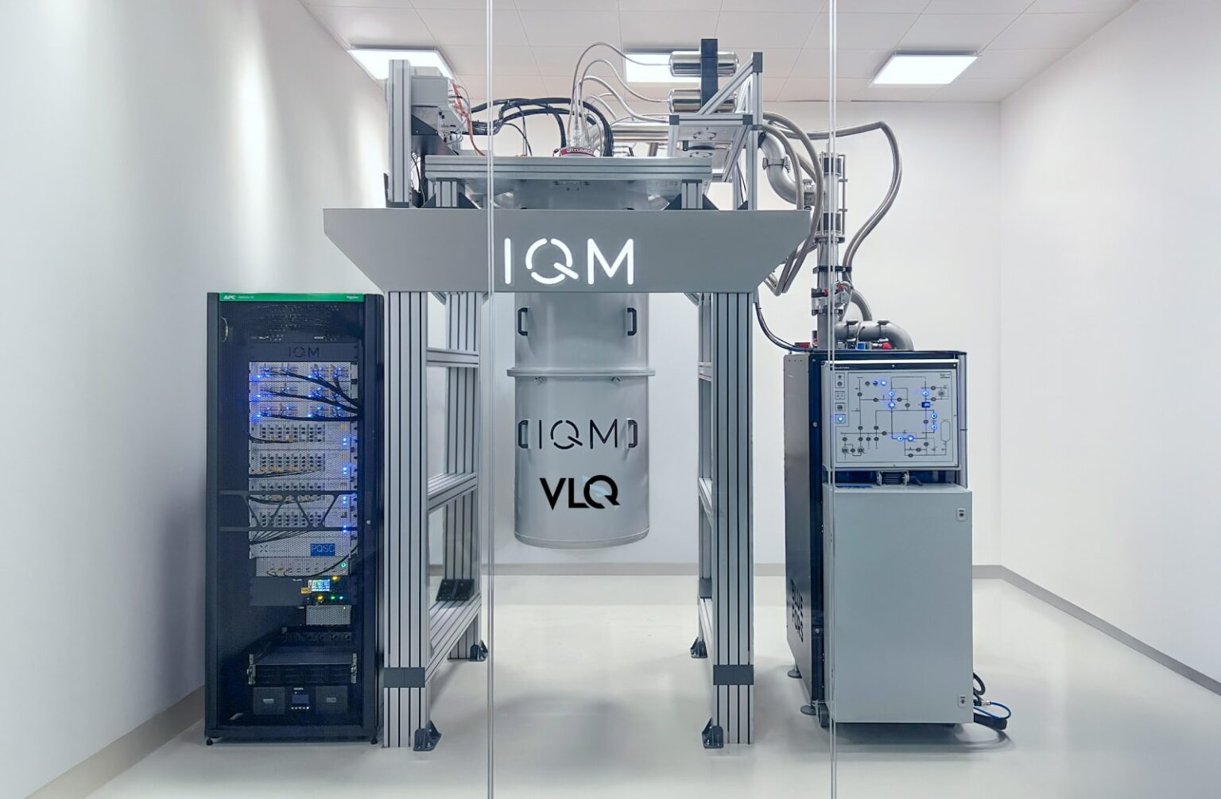
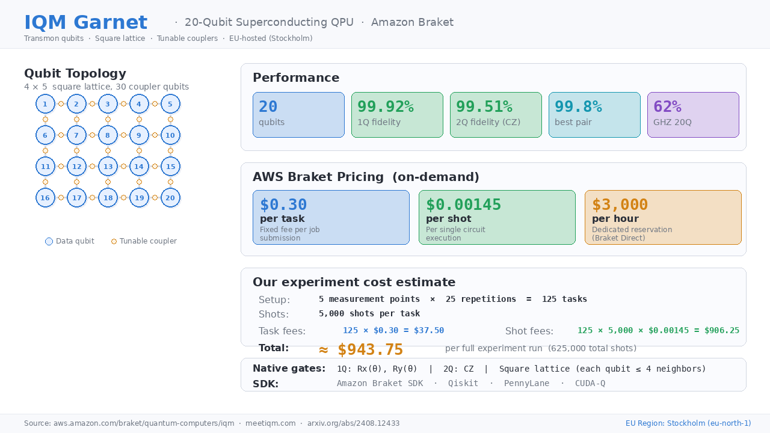
IQM Garnet Processor
20 qubits superconducting system
Repetition 25 shots 5000

Slide 13
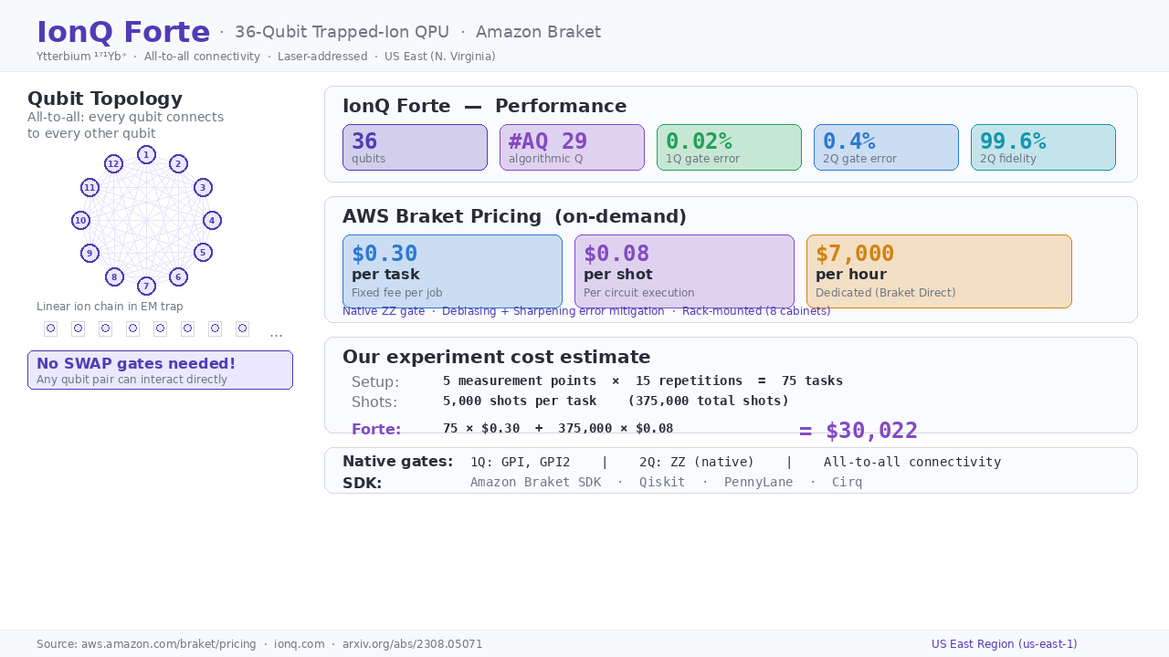
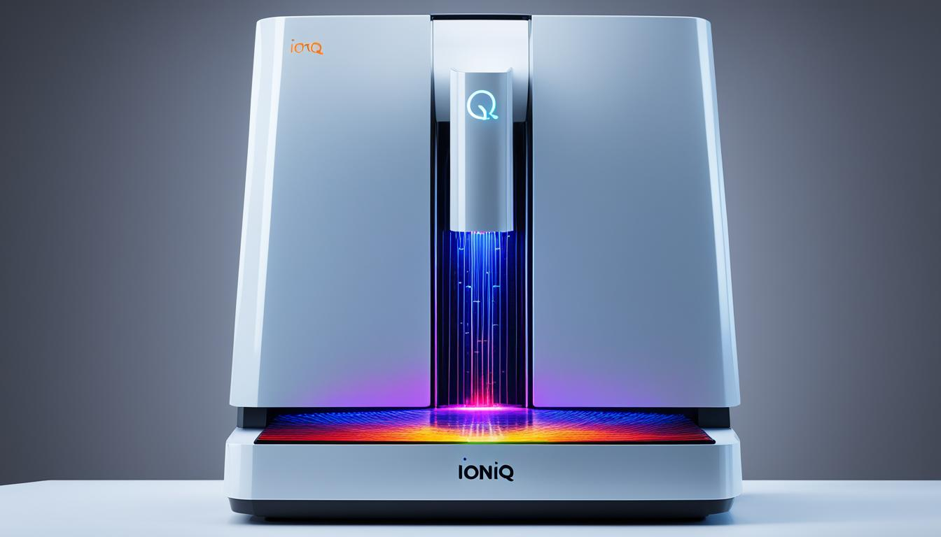
IonQ Forte Processor
36 qubits trapped-ion
Repetition 15 shots 5000

Slide 14
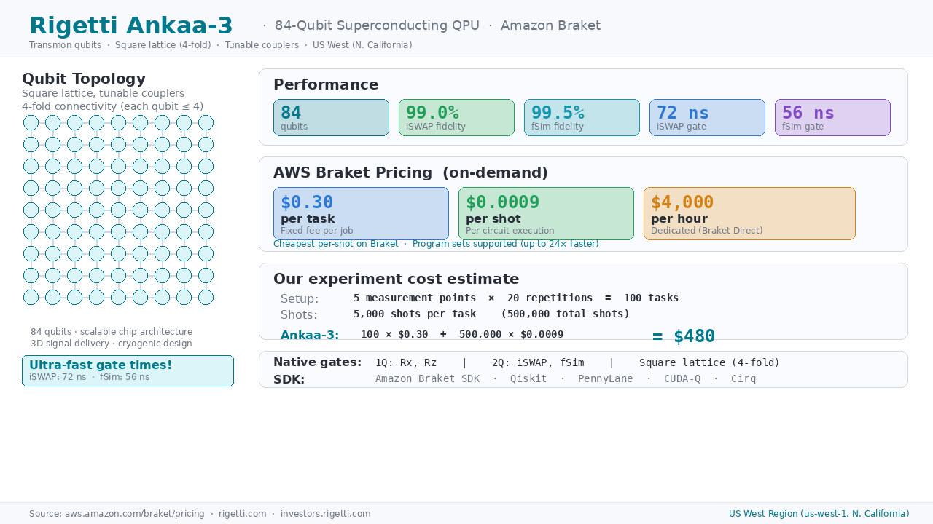
Rigetti Ankaa-3 Processor
84 qubits superconducting
Repetition 15 shots 5000

Slide 15
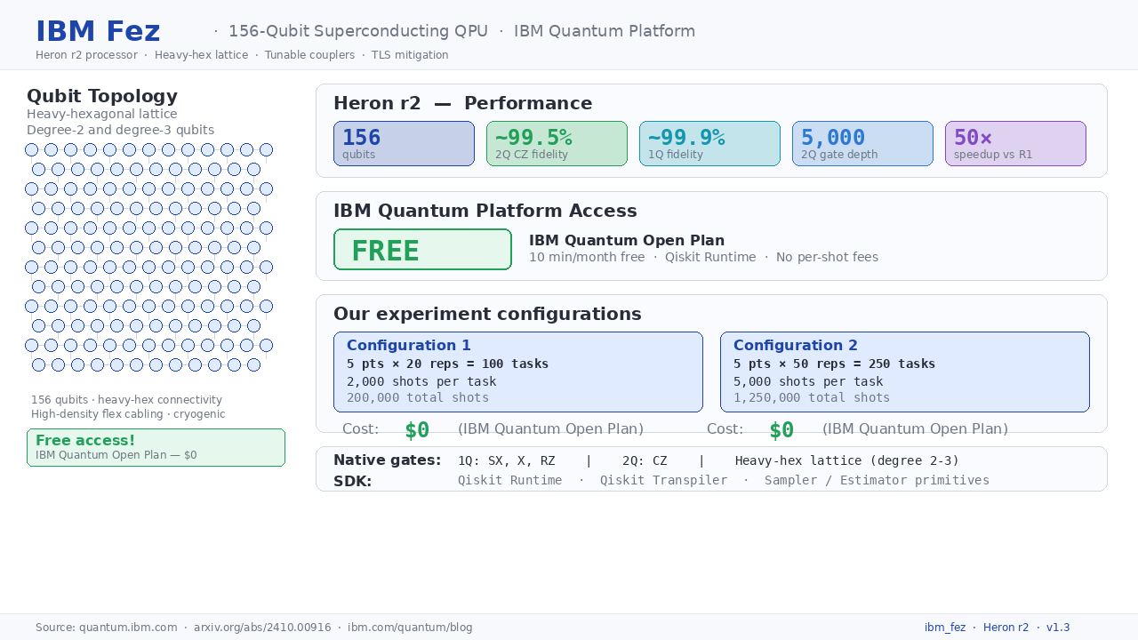
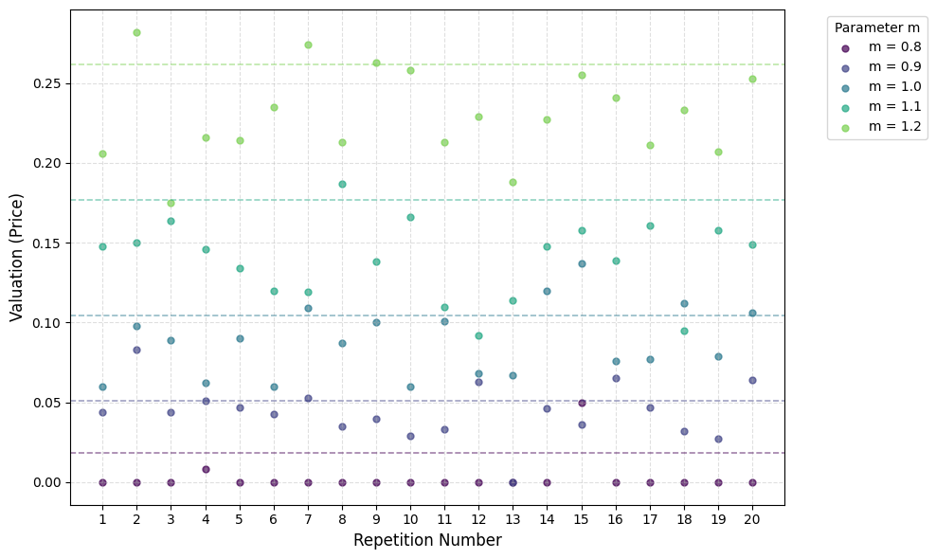
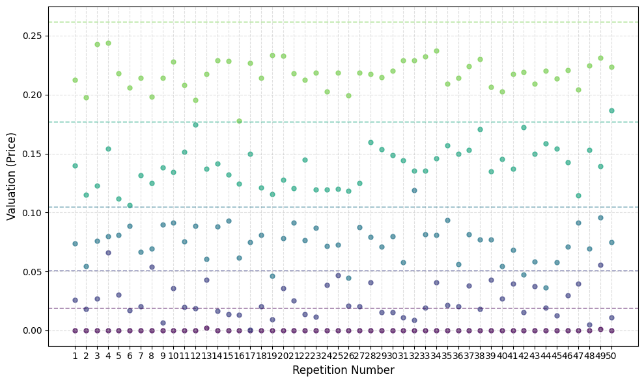
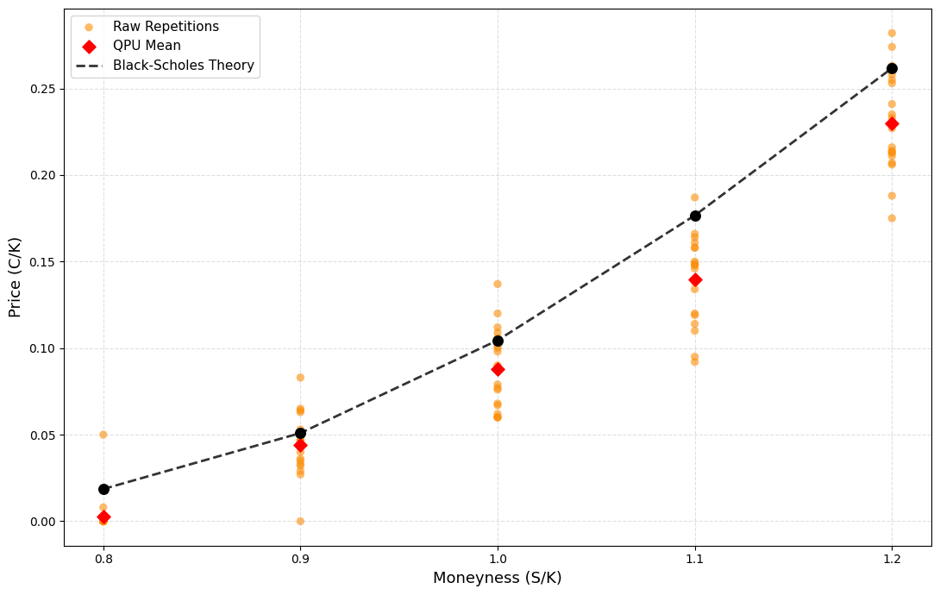
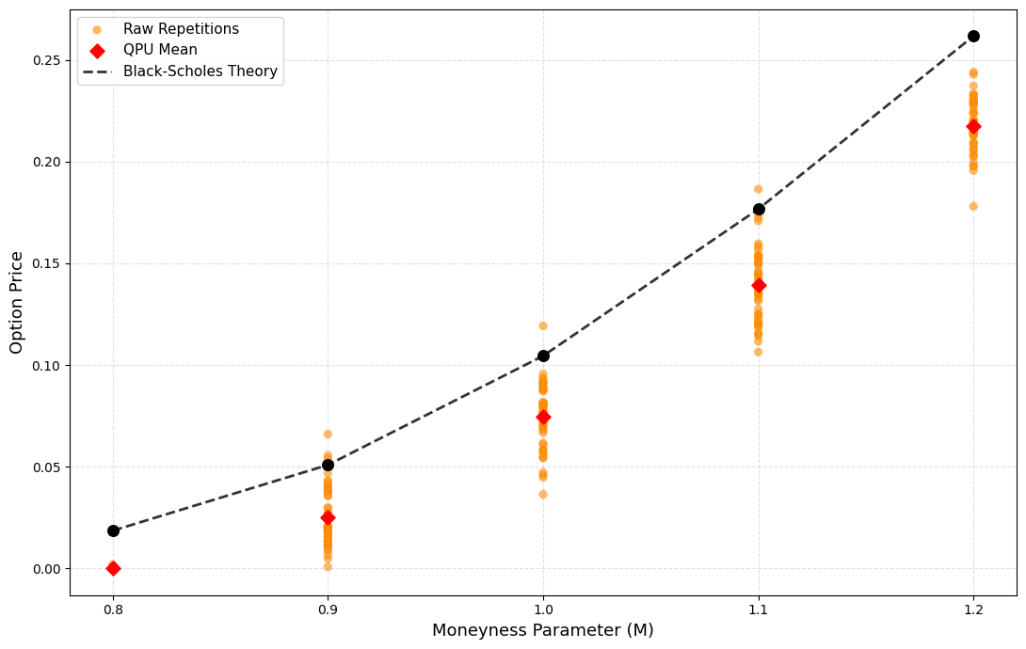
IBM Fez Heron
156 qubits superconducting
Repetition 20 shots 2000, R 50 s 5000

Slide 16
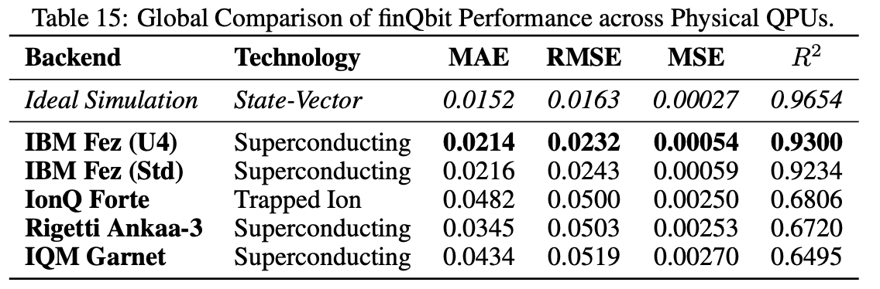
QPU Summary

Slide 17
Summary
QNN-based framework for option pricing on NISQ devices
Black-Scholes-Merton model as a benchmark
End-to-End implementations of a fully QNN pricing workflow
IBM Fez, IQM Garnet, IonQ Forte, Rigetti Ankaa-3
Proposed finQbit 2 qubits architecture
Future research
More realistic stochastic models (Heston…)
Exotic and path-dependent derivatives (American, Asian …)
Integration with Quantum Amplitude Estimation
More …

Slide 18
Thank you

